Slide 1
Information System Project
Lecture 1 & 2: Introduction to Project Planning and Management
- Doan Trung Tung -

Slide 2
In this lecture
Project
Definition
Successful rate
Successful factors
Project life cycle
Project Management
Concept
Triple constraint
Project manager
Stages in PM

Slide 3
PROJECT

Slide 4
What is a project?
Unique set of coordinated activities, with a definite starting and finishing points, undertaken by an individual or an organization to meet specific objectives within defined schedule, cost and performance parameters (British Standard 60971, 2000:2)
Notes:
example of a project

Slide 5
What is a project?
Financial
Legal
Ethical
Environmental
Logic
Time
Quality
Input
resources
Output
(product/
service)
The project
transformation process
Customers
People
Knowledge
Expertise
Capital
Tools
Technology
Notes:
Constraint: Financial, Legal, Ethical, …
Mechanism

Slide 6
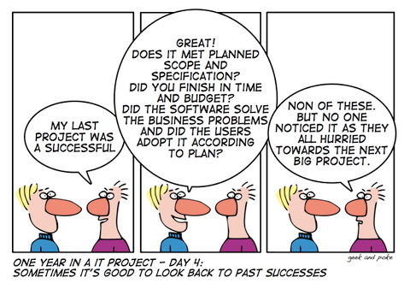
What is a successful project?
Complete on time or earlier.
Do not be surpassed the budget.
Meet the specifications to the contentment of the customer

Slide 7
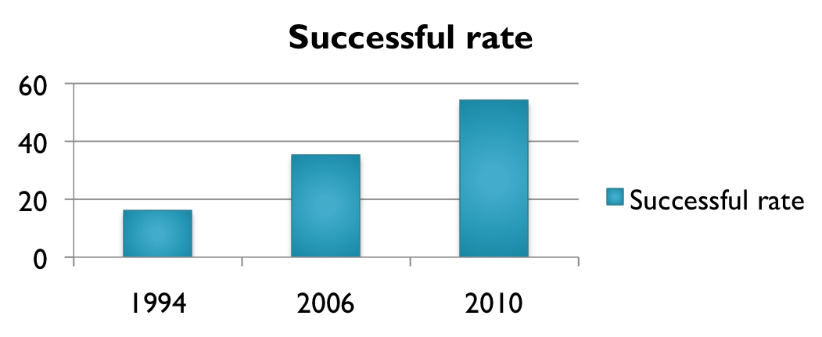
Project’s successful rate
1994: 16% of IT projects were successful, 31% cancelled before completion, and 53% completed badly (CHAOS study)
2006: 35% successful, 19% failed, and 46% weak
2010: 47% - 61% successful
http://drdobbs.com/architecture-and-design/226500046

Slide 8
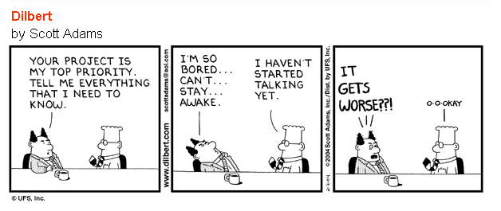
Reasons for failure
Bad communication
Incomplete requirements
Changing requirements and specs
Lack of / Unsuitable technology
Incompetence
Lack of resources
Unrealistic expectations
Notes:
Communication: The #1 reason for project failure, and a factor in many other causes
customer doesn’t know well about problem
in theory you can use any language to solve a problem but …
incompetence: project manager, team member, …
unrealistic: train to moon

Slide 9
Project successful factors
Stakeholder involvement
Clear statement of requirements
Proper planning
Realistic expectations
Project milestones
Competent staff
Hard working and focused staff
…
Notes:
a person, group or organization with an interest in a project (invest money to project)
To increase the chances of positive outcome, project managers have to think about all of the factor that can influence positive outcome and the threat of failure
high expectation = high risk
competent = có trình độ

Slide 10
Project attributes
Goal
Time
Ownership
Resources
Roles
Tasks
Risks
Notes:
Goal: meet or exceed stakeholders’ needs and expectations
Resources: all kind of resources – human resources, budget, machines, technology
Risks: changes, technical limitation, key employee leaves, value of money

Slide 11
Project life cycle
The project life cycle defines the life of a project in phases
Initiation
Defines the project objectives and grants authority to the project manager.
Planning
Refines the project objectives and scope and plans the steps necessary to meet the project’s objectives.
Executing
Puts the project plan into motion
Measures the performance of the executing activities and compares the results with the project plan.
Closing
Documents the formal acceptance of the project’s product and brings all aspects of the project to a close.

Slide 12
Project life cyle
Client Statement of Work
Project Monitoring
Revised
Project Plan
Preliminary Project Plan
Project Execution
Internal Review
Work Authorization
Client Requested Changes
Proposal Project Plan
Baseline Project Plan
Client Review/ Negotiations

Slide 13
PROJECT MANAGEMENT

Slide 14
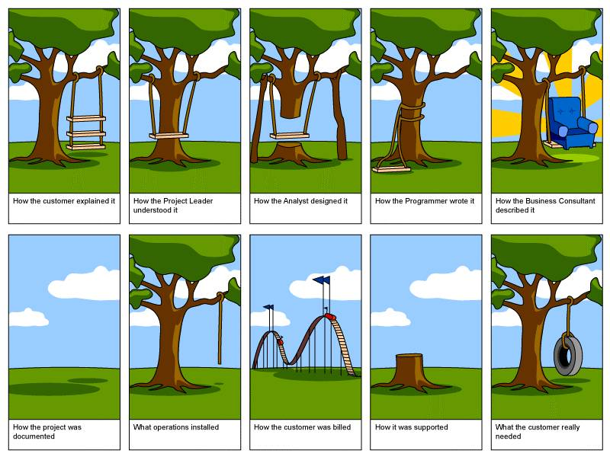

Slide 15
What is Project Management?
A systemized, phased approach to defining, organizing, planning, monitoring, and controlling projects
Project management was developed to save time / money by properly planning a project and considering all relevant factors which may affect its outcome
Notes:
Even though project management gives you set of tools to schedule and organize, there are many factors that need to be considered if projects are to be successful. It is not a magical solution
Project management does not do the work for you, but helps you to be specific and organized without losing the overview of what you are doing and why.

Slide 16
What does PM help in a project?
Plan tasks in project
Avoid problems
Reduce risks
Organize project process and timeline
Improve stakeholder - staff communication
Improve management of stakeholders’ expectations
Notes:
Track progress accurately

Slide 17
Benefits of Project Management
You will have goal clarity and measurement
Your resources will be coordinated
Your risks will be identified and managed
You will increase the possibilities of time savings
You will increase the possibilities of cost savings
You will increase the possibilities of achieving the agreed outcome
You will increase the possibilities to deliver projects successfully
Notes:
This is a list of favourable outcomes. But, just like when a contractor wants to build a house. it is not enough to bring the drawings and get the tools on location. He actually really has to do the work. The drawings guides him and the tools makes the labour easier for him.

Slide 18

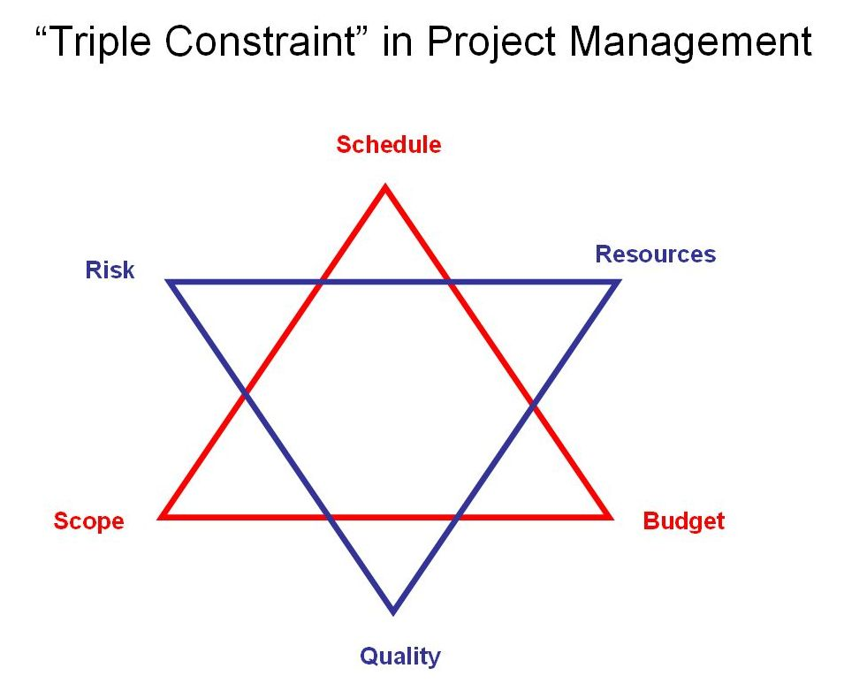
Triple constraint
Notes:
Project Scope
How much work is to be done? Increasing the scope causes more work to be done, and vice versa.
Time
The schedule of the project. Modifying the schedule alters the start and end dates for tasks in the project and can alter the project’s overall end date.
Cost
The cost required to accomplish the project’s objectives. Modifying the cost of the project generally has an impact on the scope, time, or quality of the project.

Slide 19
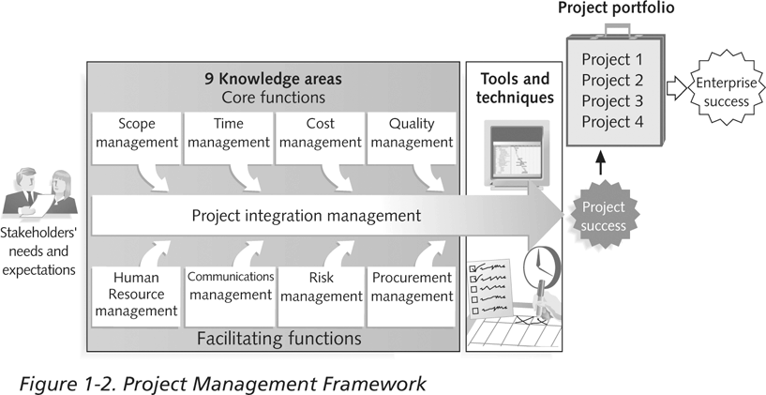
Project Management Framework

Slide 20
Project manager
Planning
Communication
Coordination
Integration
Execution
Tracking
Budgeting
Control
Reporting
Notes:
Parrot joke: a men goes to a pet shop to buy a parrot. one knows c++, one know c#, the other who knows nothing is project manager
What does a developer do in an IT project?

Slide 21
Role of a project manager
The role of a project manager is affected by the one-shot nature of the project
The role of a project manager is difficult when team members are still linked to their permanent work areas
Members may be assigned to several projects simultaneously
Managers must rely on their communication skills and powers of persuasion
Notes:
If people are put in a project group, how do you make them work on the project as well as making them perform their normal duties as well?

Slide 22

Project manager attributes
Leader & manager
Facilitator, coordinator
Communicator
Credibility: Technical/ Administrative
Work under pressure
Goal-oriented
Innovator
Flexible
Knowledgeable about the organization
Sense
Confront
Can deal with stress, chaos, ambiguity
Planning and follow-through
Notes:
Project manager has to be able to fulfil the needs and demands of the project
sense: trực giác eg: believe st is right, foresee risks
confront: accept challenge

Slide 23
Project manager duties
Reports to senior management
Communicates with users
Plans and schedules
Obtains and allocates resources
Controls risks
Manages people
Coordinates
Implements quality assurance
Controls the budget
Delivers results
Notes:
Whatever needs to be done, has to be done by a project manager, even though it involves him/her decide that some one else should do the actual work!

Slide 24
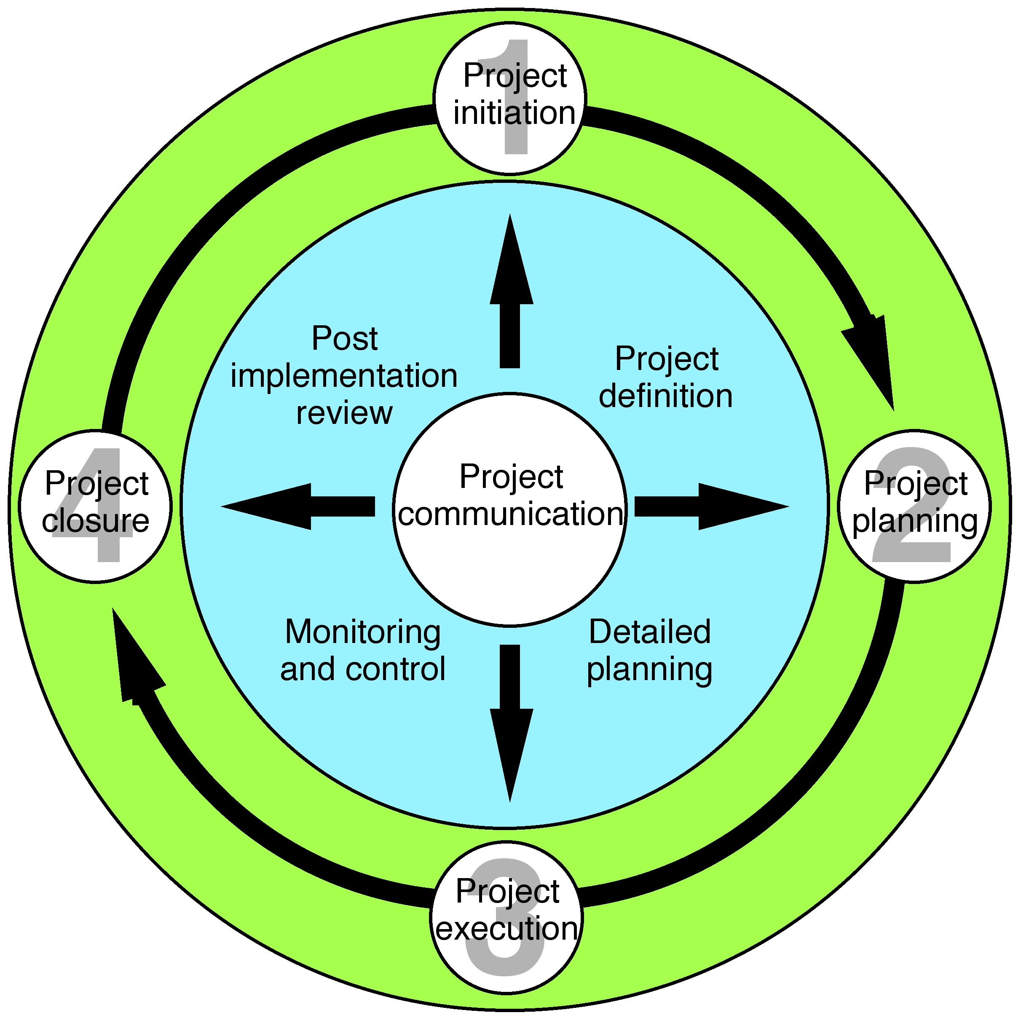
Project Managements and Project Life Cycle
Managing a project = Managing stages of project life cycle
Notes:
Each project has its own life cycle which contain similar stages therefore require similar project managements processes.
The thing that makes a project unique is the deliverables that each project builds. We can apply the same methodology for different projects.
We approach a project from its life cycle perspective. Managing a project = managing stages of its life cycle

Slide 25
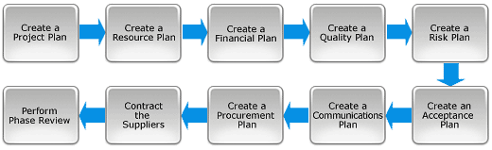
Project planning
Project planning involves creating a suite of planning documents to help guide the team throughout the project delivery.
Notes:
The Planning Phase involves completing the following 10 key steps:

Slide 26
Project planning
A Project Plan sets out the phases, activities and tasks needed to deliver a project. The timeframes required to deliver the project, along with the resources and milestones are also shown in the Project Plan.
Notes:
The Project Plan is referred to constantly throughout the project. Every day, the Project Manager will review actual progress against that stated in the Project Plan, to ensure they are still on track. The Project Plan is therefore the most critical tool a Manager can have to successfully deliver projects.

Slide 27
Project planning
A Resource Plan summarizes the level of resources needed to complete a project. A properly documented Resource Plan will specify the exact quantities of labor, equipment and materials needed to complete your project.
Notes:
Anyone responsible for Project Resource Management will need to create a comprehensive Resource Plan, to ensure that all of the resources needed to complete the project are identified. By implementing proper Resource Planning practices, it also helps you with budgeting and forecasting project expenditure.

Slide 28
Project planning
A Financial Plan identifies the Project Finance needed to meet specific objectives. The Financial Plan defines all of the various types of expenses that a project will incur along with an estimation of the value of each expense.
The Financial Plan also summarizes the total expense to be incurred across the project and this total expense becomes the project budget.
Notes:
(labor, equipment, materials and administration costs)

Slide 29
Project planning
Use Quality Plan to set quality targets by:
Identifying the customers requirements
Listing the project deliverables to be produced
Setting quality criteria for these deliverables
Defining quality standards for the deliverables
Gaining your customers agreement with the targets set
Notes:
Creating a Quality Plan is essential if you want to provide the customer with confidence that you will produce a solution that meets their needs. The Quality Plan states everything you're going to do, to ensure the quality of your solution.

Slide 30
Project planning
Risk Planning will help to:
Identify risks within project
Categorize and prioritize each risk
Determine the likelihood of the risks occurring
Identify the impact on the project if risk does occur
Notes:
A Risk Plan helps you to foresee risks, identify actions to prevent them from occurring and reduce their impact should they eventuate.
The Risk Plan is referred to frequently throughout the project, to ensure that all risks are mitigated as quickly as possible.

Slide 31
Project planning
An Acceptance Plan is a schedule of tasks that are required to gain the customers acceptance that what you have produced is satisfactory.
Notes:
You should create an Acceptance Plan every time you need to produce a set of deliverables that require the customer's approval before completion. If the customer needs to approve anything, then you should agree upfront what actions will be taken to get their approval when the deliverables are complete. By creating an Acceptance Plan at the start of a project, it will save you time and hassle at the end, as the acceptance test actions will already have been pre-completed by the customer.

Slide 32
Project planning
Communication Plan
Identify the required communications events
Determine the method and frequency of each event
Allocate resource to communications events
Build a communication event schedule
Notes:
Whenever you have a variety of staff, external suppliers, customers and stakeholders to communicate with, then you should record your communications formally in a Communication Plan. A clear Communications Plan is vital to the success of an organization. It is also critical to the success of projects, as it ensures that all of the staff and stakeholders are kept properly informed of the progress of a project.
Remember the #1 reason of failure

Slide 33
Project planning
A Procurement Plan defines the products and services that you will obtain from external suppliers.
Define your procurement requirements
Identify all of the items you need to procure

Slide 34
PROJECT MANAGEMENT TECHNIQUES

Slide 35
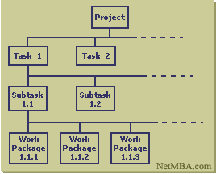
Work breakdown structure
A method of breaking down a project into individual elements ( components, subcomponents, activities and tasks) in a hierarchical structure
It defines tasks that can be completed independently of other tasks

Slide 36
Work breakdown structure
It is foundation of project planning
It is developed before estimation of activity durations
It can be used to identity the tasks in the CPM and PERT

Slide 37
Work breakdown structure
A unit of work should appear at only one place in the WBS.
The work content of a WBS item is the sum of the WBS items below it.
A WBS item is the responsibility of only one individual, even though many people may be working on it.
Each WBS item must be documented to ensure accurate understanding of the scope of work included and not included in that item.

Slide 38
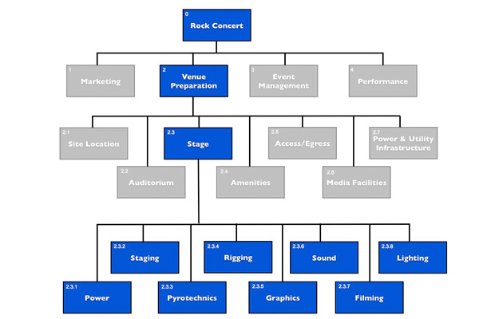
WBS example

Slide 39
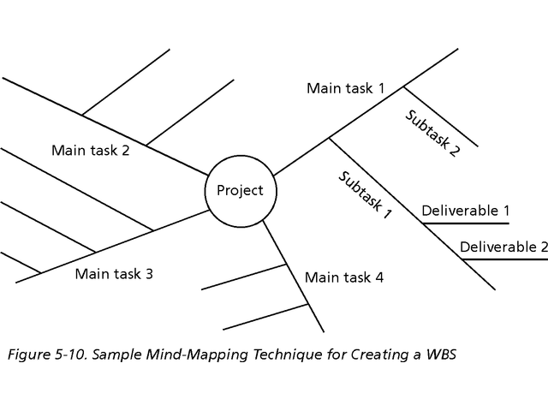
Approaches to Developing WBSs
The top-down approach: Start with the largest items of the project and break them down
Mind-mapping approach: Write down tasks in a non-linear format and then create the WBS structure

Slide 40

The Work Breakdown Structure - 3
LEVEL
DESCRIPTION
1
Total Program
Usually specified by the client and managed the project manager.
2
Project(s)
3
Task(s)
4
Subtask(s)
Usually specified by the functional manager(s).
5
Work Package(s)
6
Level of Effort
Most common type: Six-Level Indented Structure

Slide 41
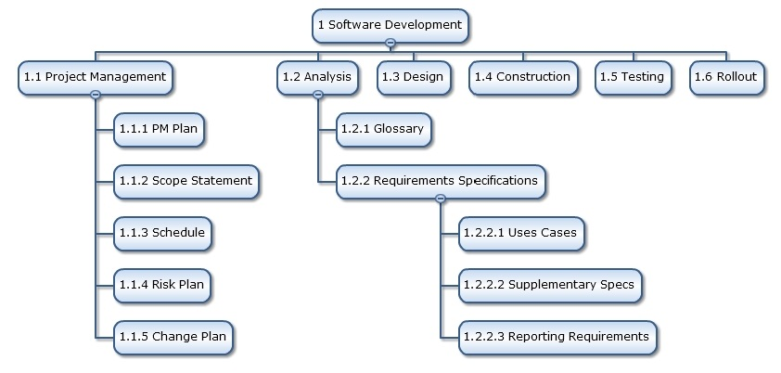
WBS example for IT project

Slide 42
Gantt chart
Henry Gantt, an American engineer, created the Gantt chart in 1917
Graph or bar chart with a bar for each project activity that shows passage of time
Provides visual display of project schedule

Slide 43
Gantt Chart
Gantt charts provide a standard format for displaying project schedule information by listing project activities and their corresponding start and finish dates in a calendar format
Symbols include:
A black diamond: milestones or significant events on a project with zero duration
Thick black bars: summary tasks
Lighter horizontal bars: tasks
Arrows: dependencies between tasks

Slide 44
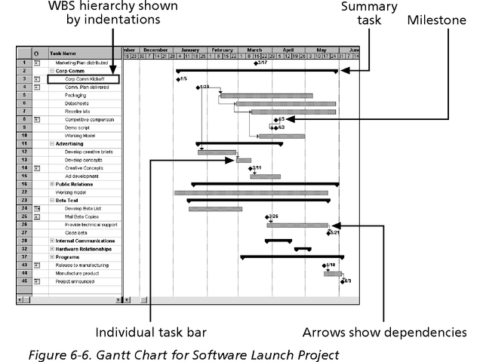
Gantt Chart

Slide 45
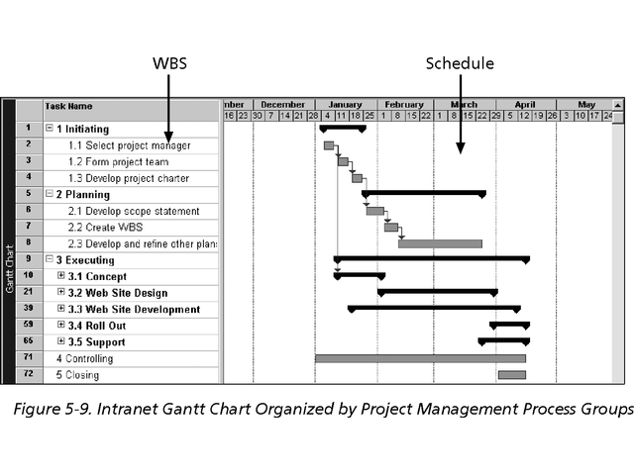
WBS and Gantt chart

Slide 46
Gantt chart tools
MS Project:
https://www.youtube.com/watch?v=J9uctgUaEic
Excel:
https://www.youtube.com/watch?v=-oD50HSBBBI
Online tool:
https://vizzlo.com/for/project-managers

Slide 47
Network analysis
Network analysis is the general name given to certain specific techniques which can be used for the planning, management and control of projects
Use of nodes and arrows
Arrows: Indicate ACTIVITY, a time consuming effort that is required to perform a part of the work
Nodes: Indicate EVENT, a point in time where one or more activities start and/or finish.

Slide 48
Network analysis
Activity
A task or a certain amount of work required in the project
Requires time to complete
Represented by an arrow
Dummy Activity
Indicates only precedence relationships
Does not require any time of effort

Slide 49
Project network
Event
Signals the beginning or ending of an activity
Designates a point in time
Represented by a circle (node)
Network
Shows the sequential relationships among activities using nodes and arrow
Activity-on-node (AON)
nodes represent activities, and arrows show precedence relationships
Activity-on-arrow (AOA)
arrows represent activities and nodes are events for points in time

Slide 50
Project network
AOA Project Network for House Project
3
Lay foundation
Dummy
2
0
Build house
Finish work
1
3
2
1
4
6
7
Design house and obtain financing
Order and receive materials
3
1
1
1
Select paint
Select carpet
5

Slide 51
Project network
AON Project Network for House Project
Lay foundations
Build house
2
4
2
3
Finish work
7
Start
1
1
3
Design house and obtain financing
3
6
1
5
1
1
Select carpet
Order and receive materials
Select paint

Slide 52
Project network
B
A
A must finish before either B or C can start
C
A
C
both A and B must finish before C can start
B
A
C
both A and B must finish before either of C or D can start
B
A
D
B
A must finish before B can start
both A and C must finish before D can start
Dummy
C
D

Slide 53
Project network
3
Lay foundation
Lay
foundation
Dummy
2
3
2
0
1
2
4
Order material
Order material
(a) Incorrect precedence relationship
(b) Correct precedence relationship

Slide 54
Critical Path Method (CPM)
E I Du Pont de Nemours & Co. (1957) for construction of new chemical plant and maintenance shut-down
Deterministic task times
Activity-on-node network construction

Slide 55
CPM Calculation
Path
A connected sequence of activities leading from the starting event to the ending event
Critical Path
The longest path (time); determines the project duration
Critical Activities
All of the activities that make up the critical path

Slide 56
CPM Calculation
Earliest Start Time (ES)
earliest time an activity can start
ES = maximum EF of immediate predecessors
Earliest finish time (EF)
earliest time an activity can finish
EF= ES + t

Slide 57
CPM Calculation
Latest Start Time (LS)
Latest time an activity can start without delaying critical path time
LS= LF - t
Latest finish time (LF)
latest time an activity can be completed without delaying critical path time
LS = minimum LS of immediate predecessors

Slide 58
CPM example
f, 15
g, 17
h, 9
a, 6
i, 6
b, 8
d, 13
j, 12
c, 5
e, 9

Slide 59
CPM example
f, 15
g, 17
h, 9
a, 6
0
6
i, 6
b, 8
0
8
d, 13
j, 12
c, 5
0
5
e, 9

Slide 60
CPM example
f, 15
6
21
g, 17
h, 9
a, 6
21
30
0
6
6
23
i, 6
23
29
b, 8
0
8
d, 13
j, 12
8
21
21
33
c, 5
0
5
e, 9
Project’s EF = 33
5
14

Slide 61
CPM example
f, 15
6
21
h, 9
21
30
a, 6
g, 17
24
33
0
6
6
23
i, 6
23
29
b, 8
27
33
0
8
d, 13
j, 12
8
21
21
33
c, 5
21
33
0
5
e, 9
5
14

Slide 62
CPM example
f, 15
6
21
3
h, 9
9
24
21
30
a, 6
g, 17
3
24
33
0
6
6
23
i, 6
3
4
3
9
10
27
23
29
4
b, 8
27
33
0
8
d, 13
j, 12
0
0
8
8
21
21
33
0
0
c, 5
8
21
21
33
0
5
e, 9
7
7
12
5
14
7
12
21

Slide 63
CPM example
f, 15
g, 17
h, 9
a, 6
i, 6
b, 8
d, 13
j, 12
c, 5
e, 9

Slide 64
Project Evaluation and Review Technique (PERT)
U S Navy (1958) for the POLARIS missile program
Multiple task time estimates (probabilistic nature)
Activity-on-arrow network construction

Slide 65
PERT chart symbols
Activity Name (or reference)
Initial Event (Activity1)
Earliest Event Time (EET)
Event Number
Latest Event Time (LET)
Duration
Directed Arc
Terminating Event (Activity1)
Dummy (Duration always zero)
5
Activity1
3
5
2
7
4
7
0 Dummy1

Slide 66
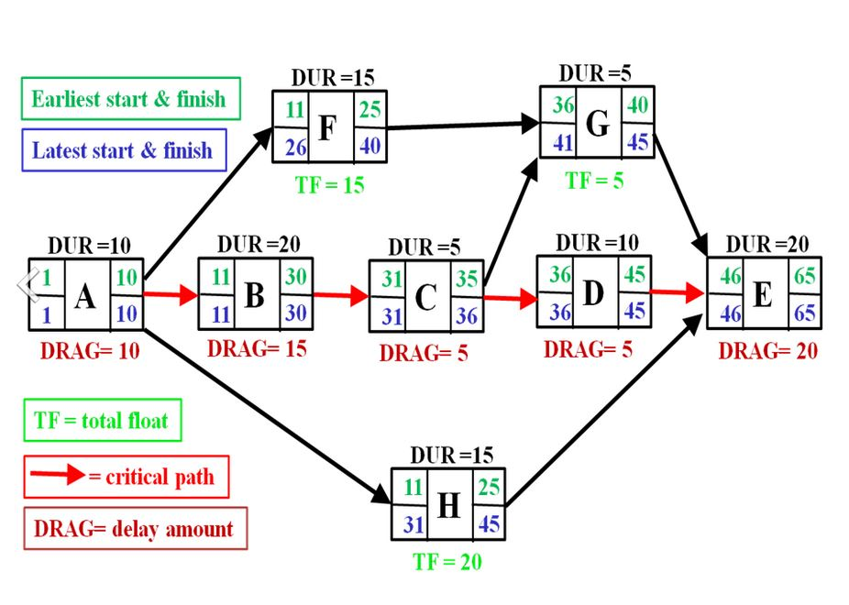
PERT example

Slide 67
References
http://www.method123.com/project-lifecycle.php
http://www.mpmm.com/project-management-methodology.php

